Slide 1
Tip of the Week January 18, 2013

Slide 2
Reimbursements

Slide 3
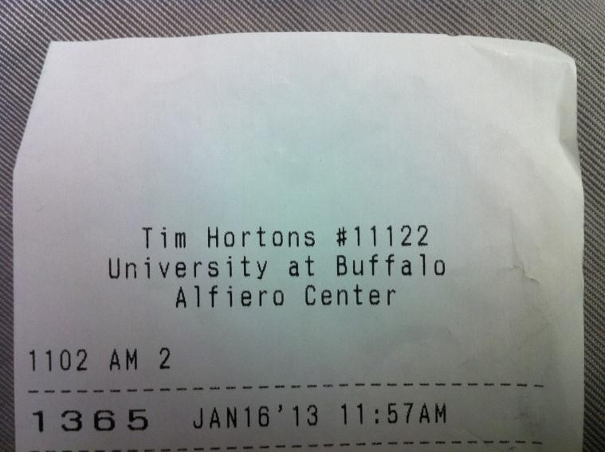
On your receipt, write down:
Your REAL NAME
Committee/Banquet/E-Board/…
Event Name & Date
Item description
$ amount to be reimbursed (OR “Already paid by AKPsi credit card/check”)

Slide 4
Sample:
Jiayue Chen (Ava)
Professional Committee
XXX Event, 1/1/13
Coffee, donuts, etc.
$30

Slide 5
**If you order is completed online, print out the electronic receipt and write down the information on top. Please give Nick your receipt within 2 weeks of your purchase.

